Slide 1
Capstone Project - 1
EDA On Hotel Booking Analysis By:- Abhishek Singh Rawat
(Cohort Madrid)

Slide 2
Problem statement:
1.For this project we will be analyzing Hotel Booking data. This data set contains booking information for a city hotel and a resort hotel, and includes information such as when the booking was made, length of stay, the number of adults, children, and/or babies, and the number of available parking spaces.
2.Hotel industry is a very volatile industry and the bookings depends on above factors and many more.
3.The main objective behind this project is to explore and analyze data to discover important factors that govern the bookings and give insights to hotel management ,which can perform various campaigns to boost the business and performance.

Slide 3
Work Flow:
So we will divide our work flow into following 3 steps.
EDA will be divided into following 3 analysis.
1)Univariate analysis: Univariate analysis is the simplest of the three analyses where the data you are analyzing is only one variable.
2)Bivariate analysis: Bivariate analysis is where you are comparing two variables to study their relationships.
3)Multivariate anlysis: Multivariate analysis is similar to Bivariate analysis but you are comparing more than two variables.
Data cleaning
Data collection And
Understanding
Exploratory Data
Analysis(EDA)

Slide 4
Data Collection And Understanding:
# After collecting data it’s very important to understand your data. So we had hotel Booking analysis data. Which had 119390 rows and 32 columns. So let’s understand this 32 columns.
Data Description:
hotel :Resort Hotel or City Hotel
is_canceled : Value indicating if the booking was canceled (1) or not (0)
lead_time : Number of days that elapsed between the entering date of the booking and the arrival date
arrival_date_year : Year of arrival date
arrival_date_month : Month of arrival date
arrival_date_week_number : Week number of year for arrival date
arrival_date_day_of_month : Day of arrival date
stays_in_weekend_nights : Number of weekend nights
stays_in_week_nights : Number of week nights.
adults : Number of adults
children : Number of children
babies : Number of babies
meal : Type of meal booked.
country : Country of origin.

Slide 5
Data Collection And Understanding:
market_segment : Market segment designation. (TA/TO)
distribution_channel : Booking distribution channel.(T/A/TO)
is_repeated_guest : is a repeated guest (1) or not (0)
previous_cancellations : Number of previous bookings that were cancelled by the customer prior to the current booking
previous_bookings_not_canceled : Number of previous bookings not cancelled by the customer prior to the current booking
reserved_room_type : Code of room type reserved.
assigned_room_type : Code for the type of room assigned to the booking.
booking_changes : Number of changes made to the booking from the moment the booking was entered on the PMS until the moment of check-in or cancellation
deposit_type : No Deposit, Non Refund , Refundable.
agent : ID of the travel agency that made the booking
company : ID of the company/entity that made the booking .
days_in_waiting_list : Number of days the booking was in the waiting list before it was confirmed to the customer
customer_type : type of customer. Contract,Group,transient,Transient party.
adr : Average Daily Rate as defined by dividing the sum of all lodging transactions by the total number of staying nights
required_car_parking_spaces : Number of car parking spaces required by the customer
total_of_special_requests : Number of special requests made by the customer (e.g. twin bed or high floor)
reservation_status : Reservation last status
.

Slide 6
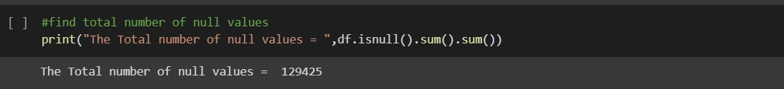
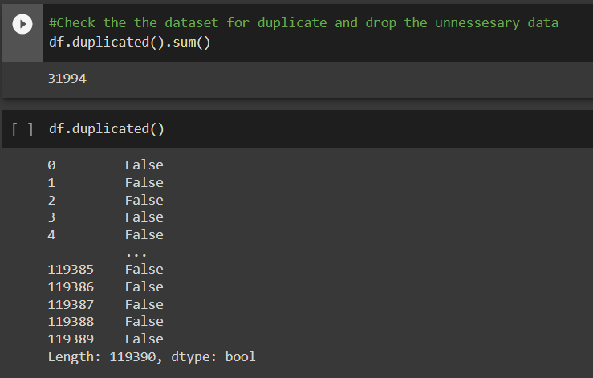
Data Cleaning:
Let check the null Values:
Handling Duplicates: Data had 31994 duplicates values. So we dropped it from the data.

Slide 7
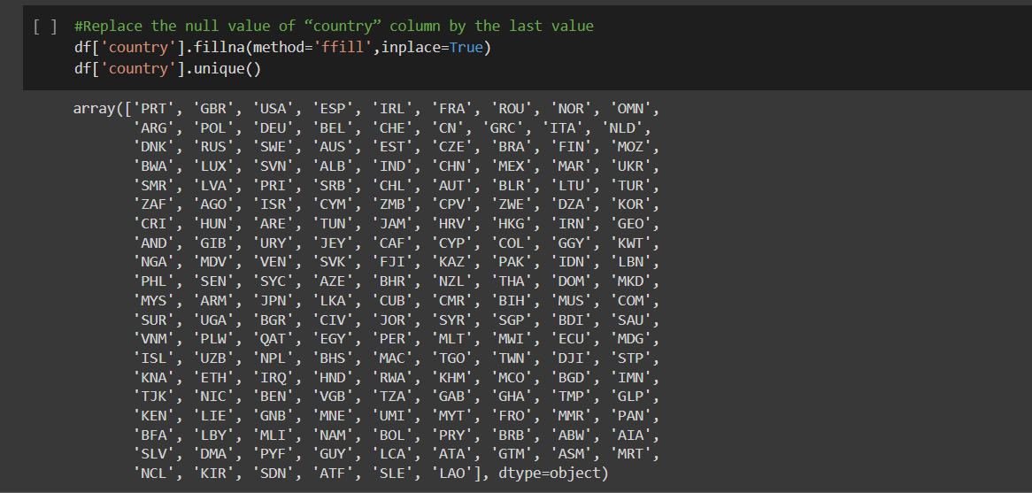
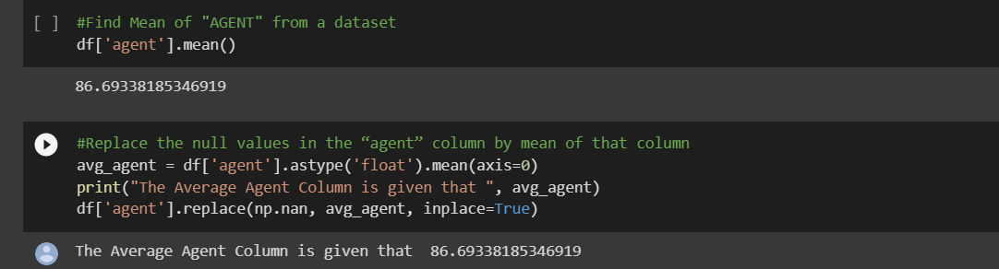
Data cleaning:
There were 3 columns Agent ,Country And Children with missing values.
So, We Replace there values Children by 0, Country by the last values, And
Agent by mean of agent column.

Slide 8
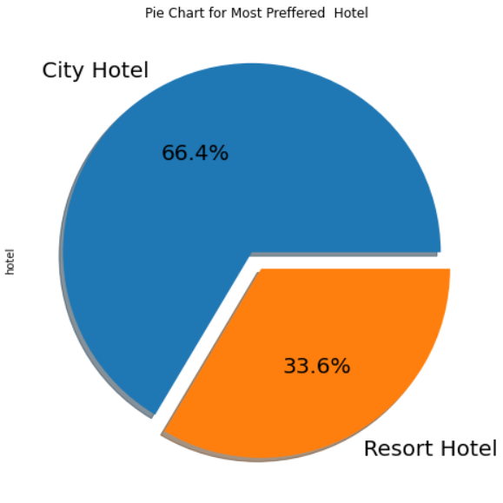
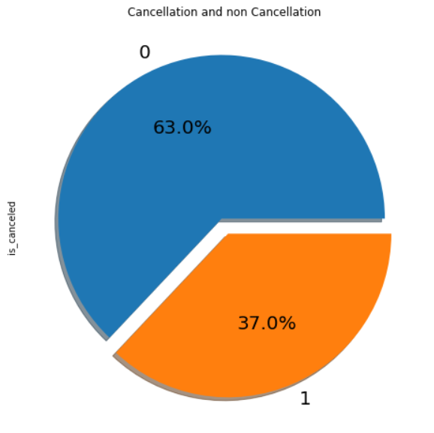
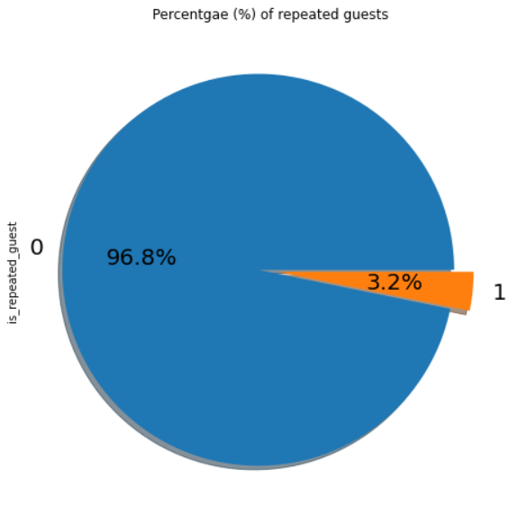
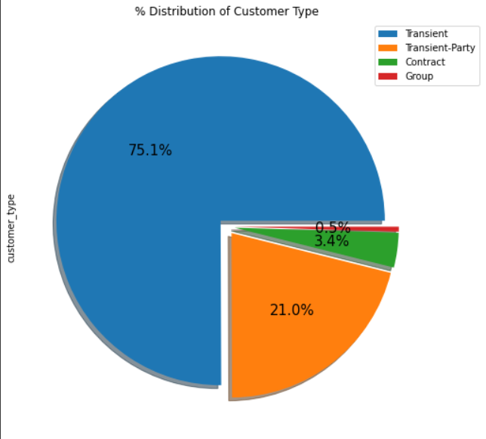
Exploratory Data Analysis(EDA):
Conclusions:
City hotels is the most preferred hotel type by the guests. We can say City hotel is the busiest hotel.
27.5 % bookings were got cancelled out of all the bookings
Only 3.9 % people were revisited the hotels. Rest 96.1 % were new guests. Thus, retention rate is low.
Most of the customers/guests were Transient type(82.4%). And transient party were 13.4% and 0.6 belongs to group. Remaining guests belongs to Contract type.
Contract-when the booking has an allotment or other type of contract associated to it
Group -when the booking is associated to a group
Transient-when the booking is not part of a group or contract, and is not associated to other transient booking
Transient-party-when the booking is transient, but is associated to at least other transient booking

Slide 9
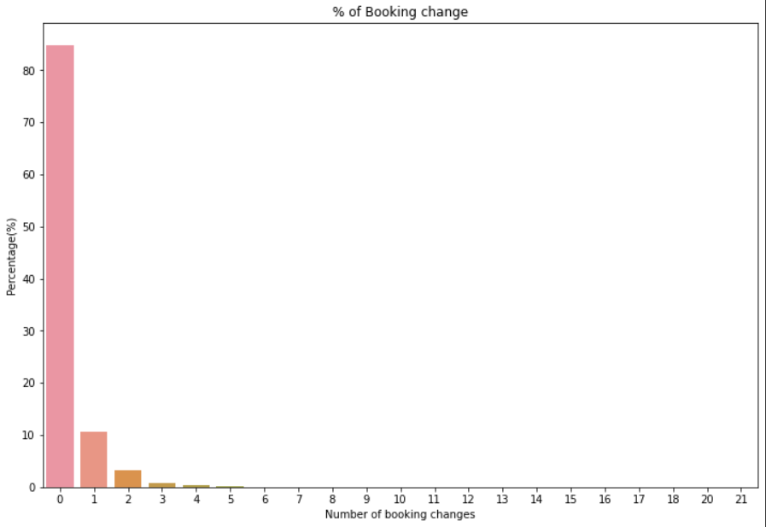
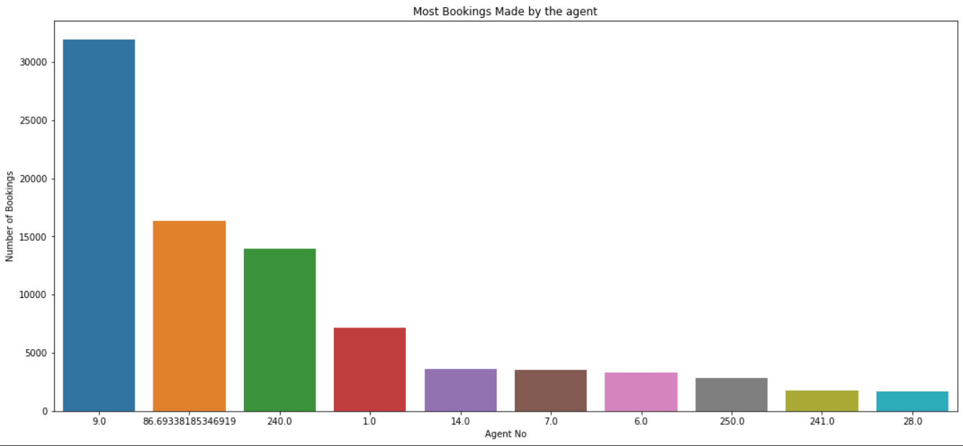
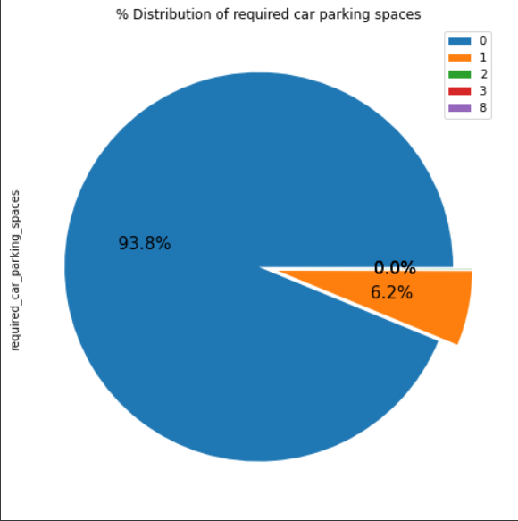
Exploratory Data Analysis(EDA):
Conclusions:
The Percentage of 0 changes made in the booking was more
Then 82%.Percentage of single changes made was about 10%.
Agent Id no-9 made the highest booking which is more than 28721.
Most Of the customers(91.6%) do not require car parking spaces.
Only 8.3% people required only 1 car parking space.

Slide 10
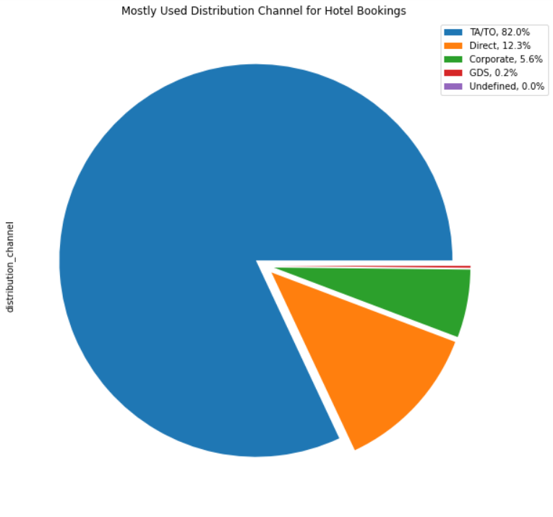
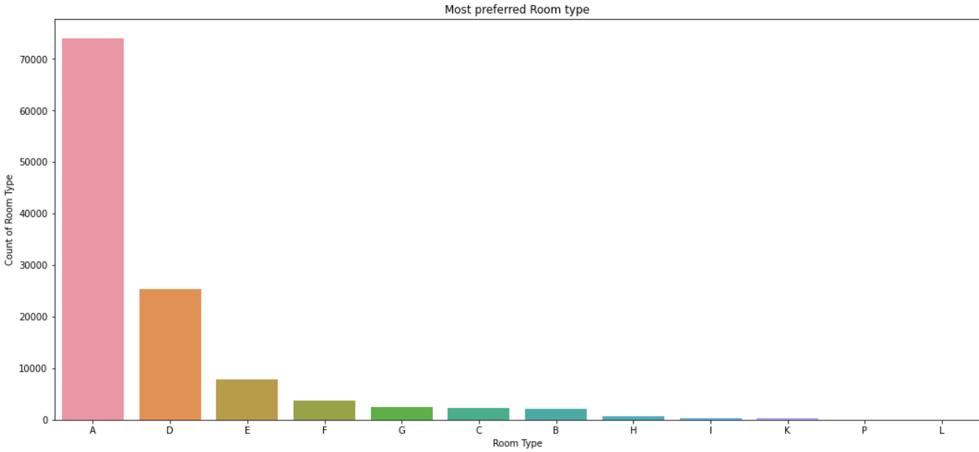
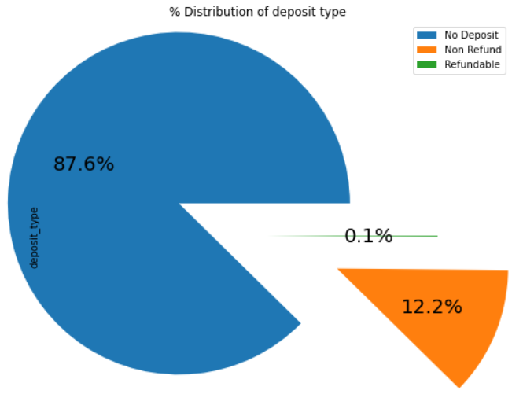
Exploratory Data Analysis(EDA):
Conclusions:
79.1 % bookings were made through TA/TO
(travel agents/Tour operators).Second most
channel is direct.
Room type ‘A’ is most preferred by
the guests second most preferred is ‘D’.
Almost 98.7% of the guests prefer ‘No deposit’ type
of criterion while booking hotels.

Slide 11
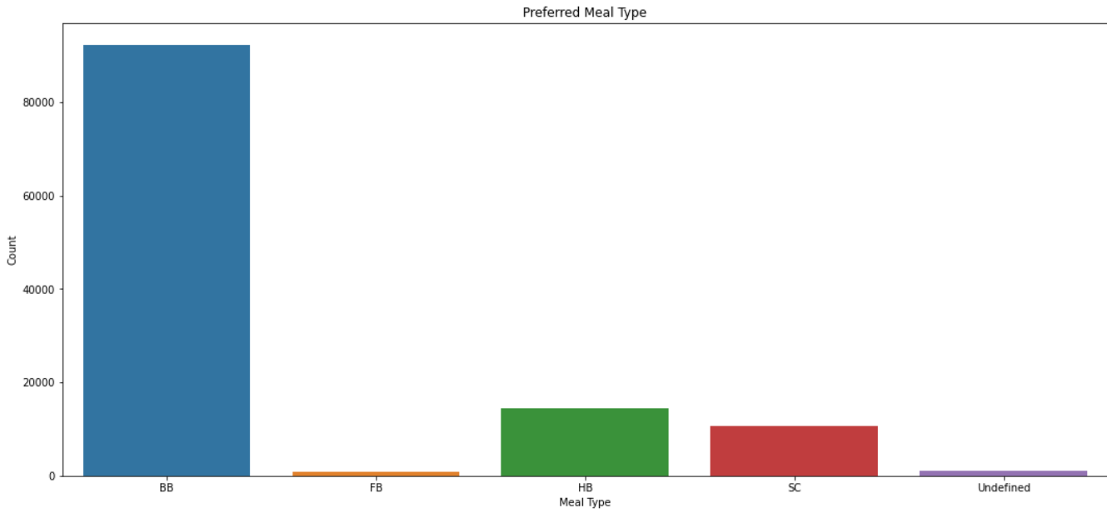
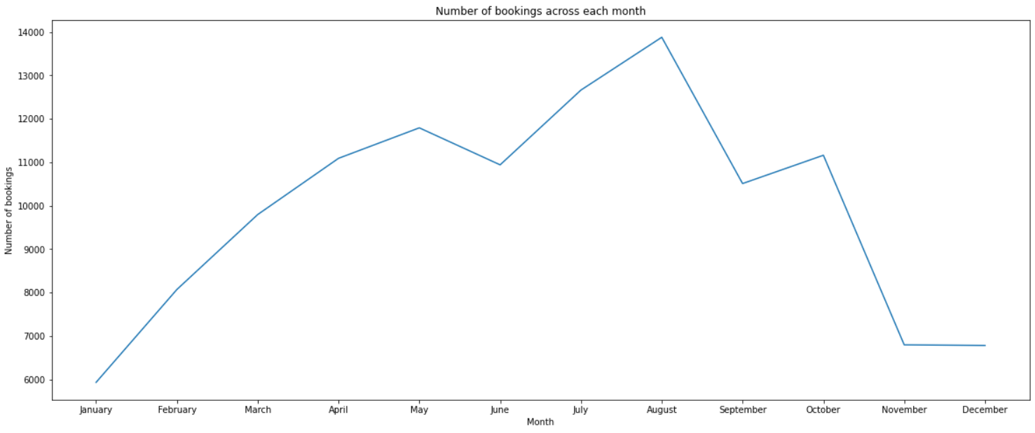
Exploratory Data Analysis(EDA):
Conclusions:
BB( Bed & Breakfast) is the most preferred
type of meal by the guests.
Full Board i.e., FB is least preferred.
HB (Half Board) and SC(Self Catering)
are equally preferred.
As we can see in the line chart,
from June to September most of the
bookings happened. It’s Summertime.
After September bookings Starts declining.

Slide 12
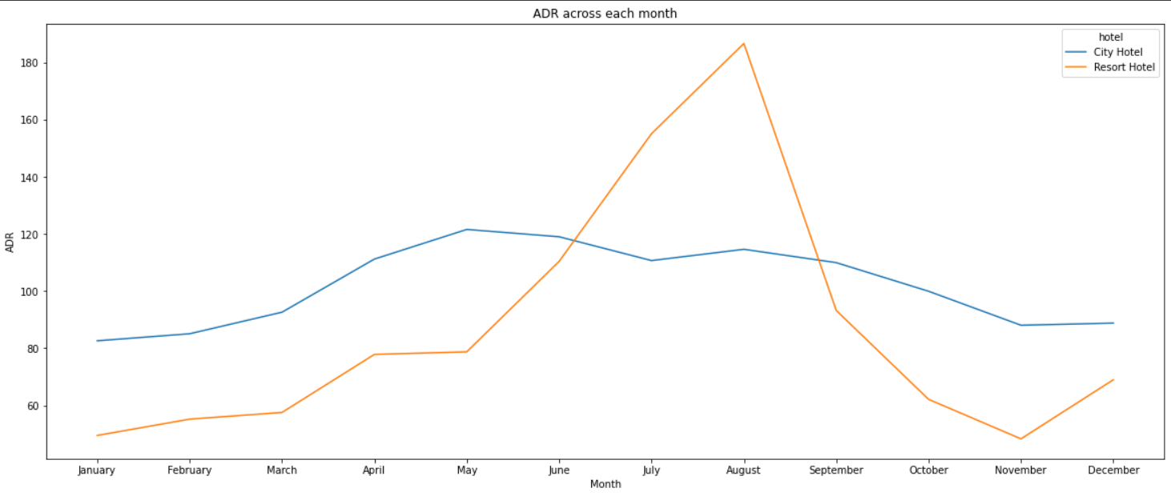
Exploratory Data Analysis(EDA):
Conclusions:
Resort hotels had the highest adr in June ,July and August than the City hotels. But in other months adr of Resort hotel was less than the City hotels.
Thus, we can say that the January, February, March, April ,November and December are the good months for customers to get good adr

Slide 13
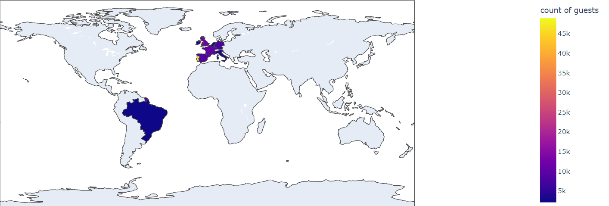
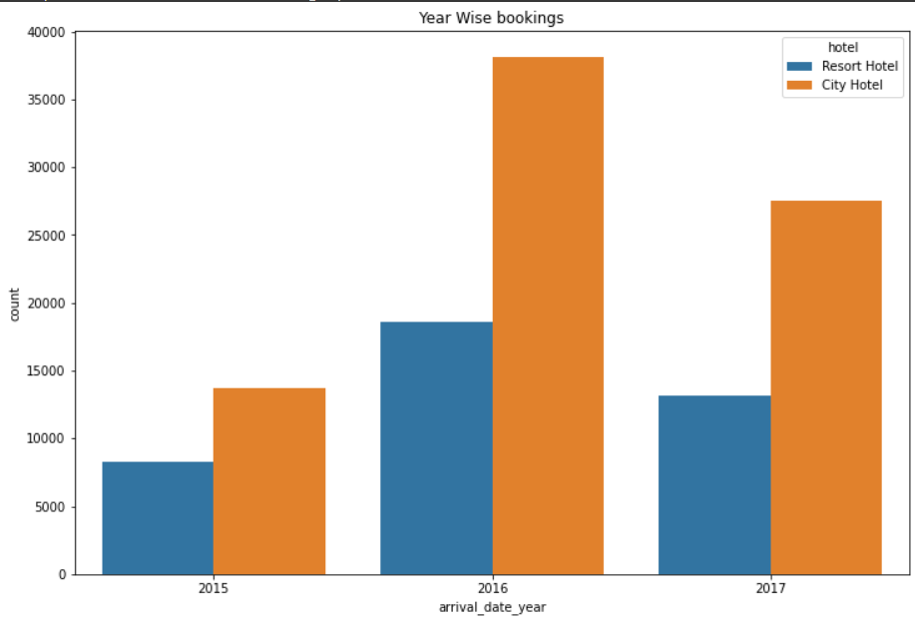
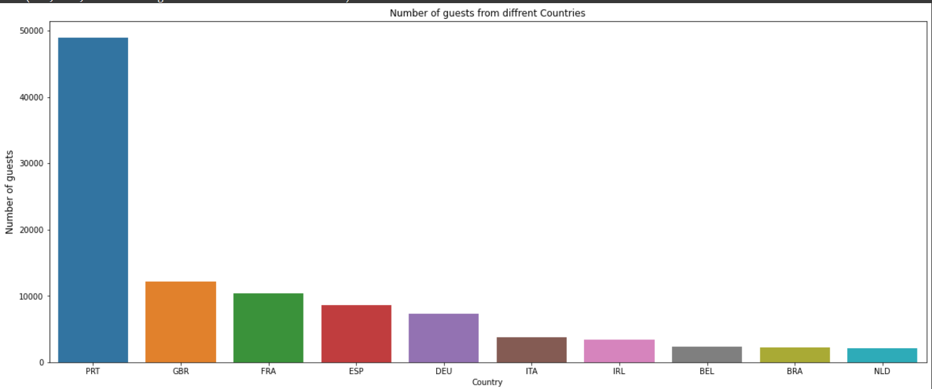
Exploratory Data Analysis(EDA):
Conclusions:
Maximum number of guests were from Portugal. i.e.,
more than 25000 guests.
After Portugal, GBR(Great Brittan),France
and Spain are the countries from where most of the
guests came.
Most of the bookings for City hotels and Resort hotel
were happened in 2016.As we can see Most of the
bookings were for City hotels.

Slide 14
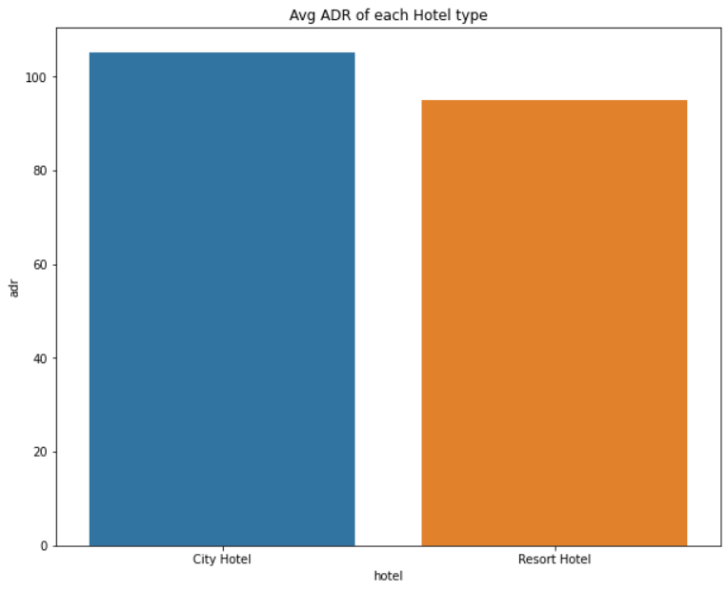
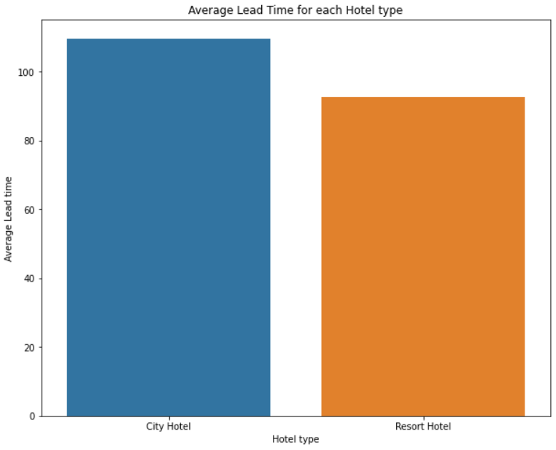
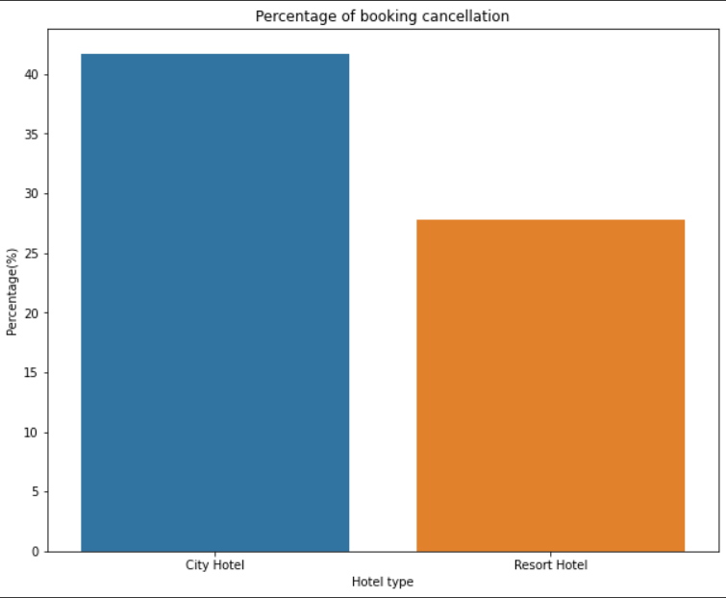
Exploratory Data Analysis(EDA):
Conclusions:
Average ADR for city hotel is high as compared to resort hotels. These City hotels are generating more revenue than the resort hotels.
Average lead time for resort hotel is high. It means people plan their trip too early. Usually people prefer resort hotels for longer stays. That’s why people plan early
Booking cancellation rate is high for City hotels which almost 30 %.

Slide 15
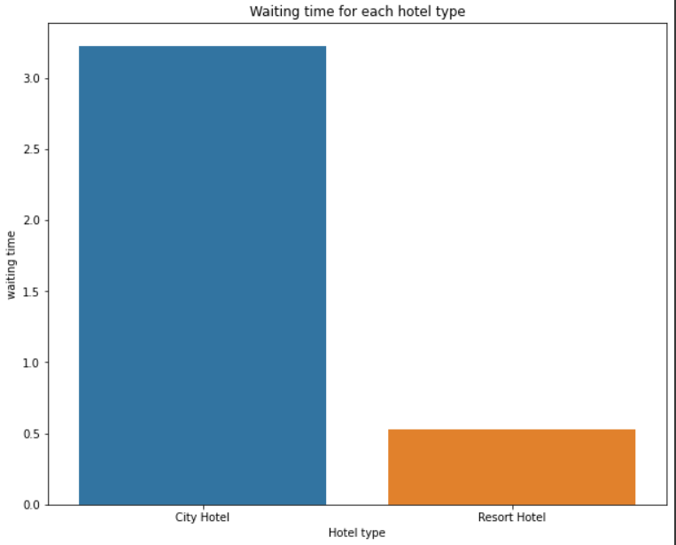
Exploratory Data Analysis(EDA):
Conclusions:
Waiting time period for City hotel is high as compared to resort hotels. That means city hotels are much busier than Resort hotels.
Resort hotels has the most repeated guests. In order to get increase the count of repeated guest's hotel management need to take the valuable feedbacks from the guests and try to give good service.

Slide 16
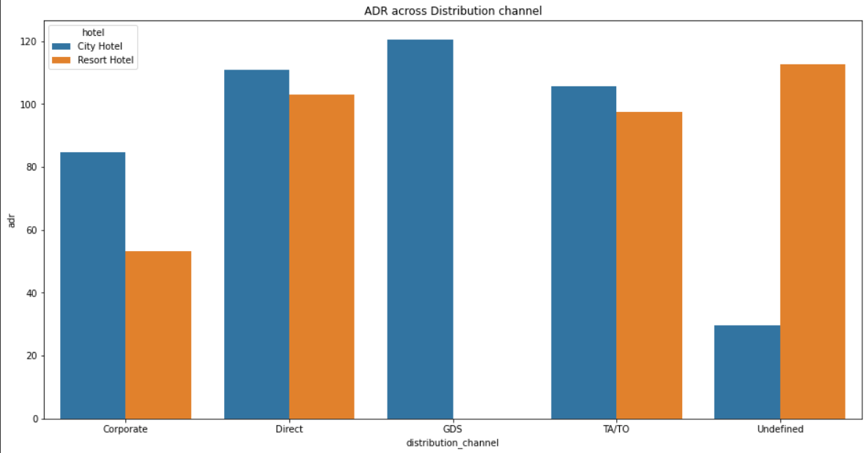
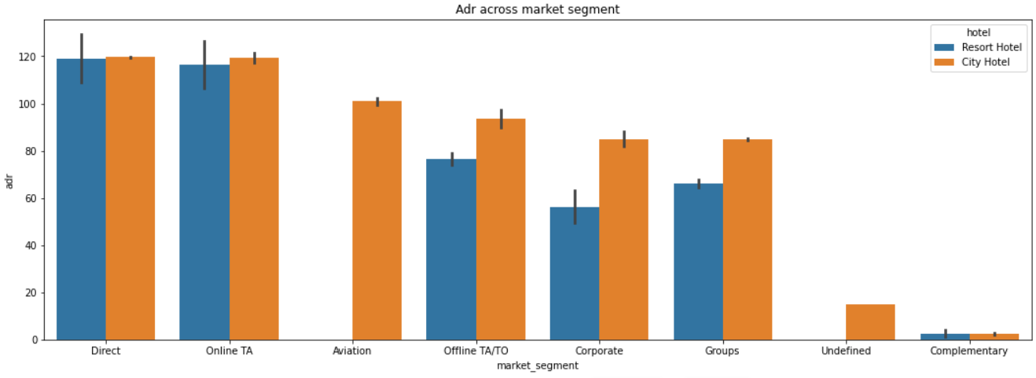
Exploratory Data Analysis(EDA):
Conclusions:
Distribution channel:
'Direct' and 'TA/TO' has almost equal adr in both type of hotels which is high among other channels.
GDS has high adr in 'City Hotel' type. GDS needs to increase Resort Hotel bookings. From this we can say that “Direct” and ‘TA/TO’ are generating more revenue than the other channels.
Market Segment:
Here “Direct” and ‘Online Travel Agency’ has high adr for both hotel types. Aviation segment needs to increase Resort hotel bookings.

Slide 17
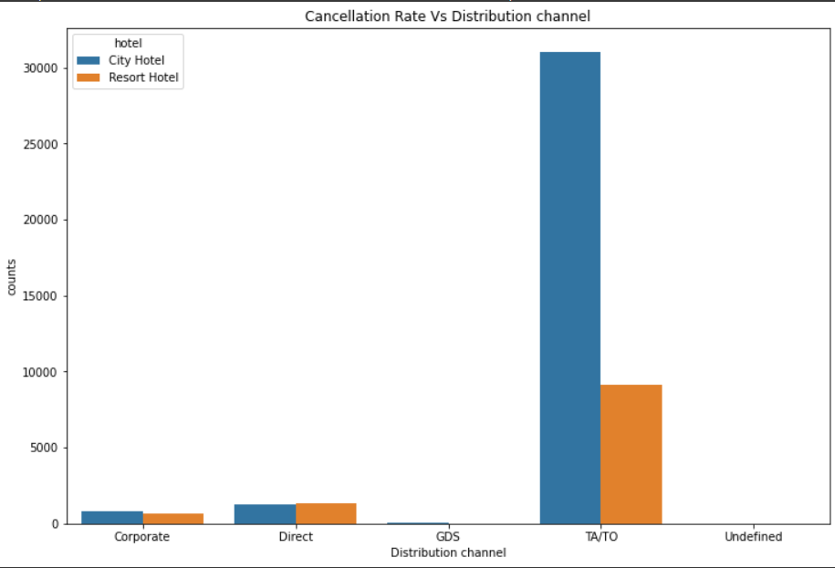
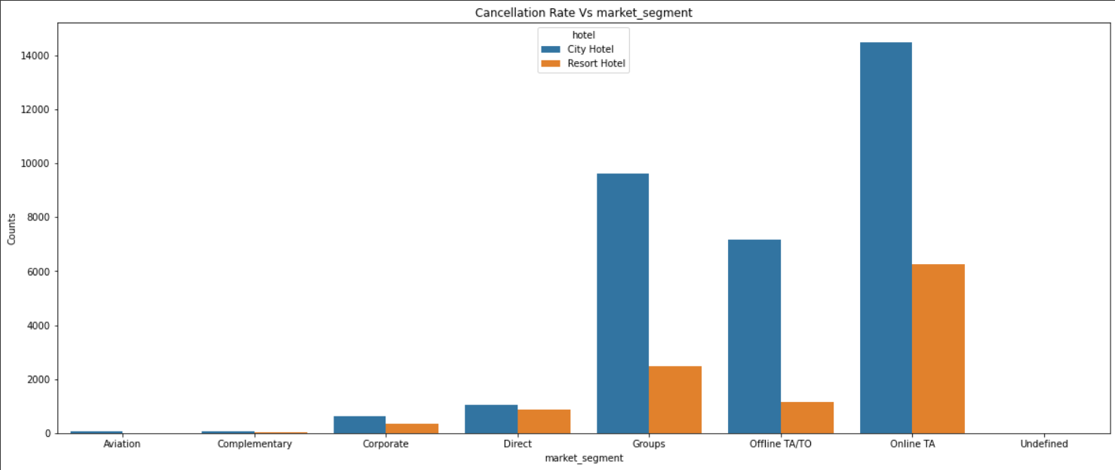
Exploratory Data Analysis(EDA):
Conclusions:
Distribution channel:
‘TA/TO’ distribution channel has highest cancellations for city hotels and more than 6000 cancellations for resort hotels. In order to reduce the cancellations they should improve their cancellation policies and deposit policies.
Market Segment:
‘Online TA/TO’ market segment has highest cancellations for city hotels.

Slide 18
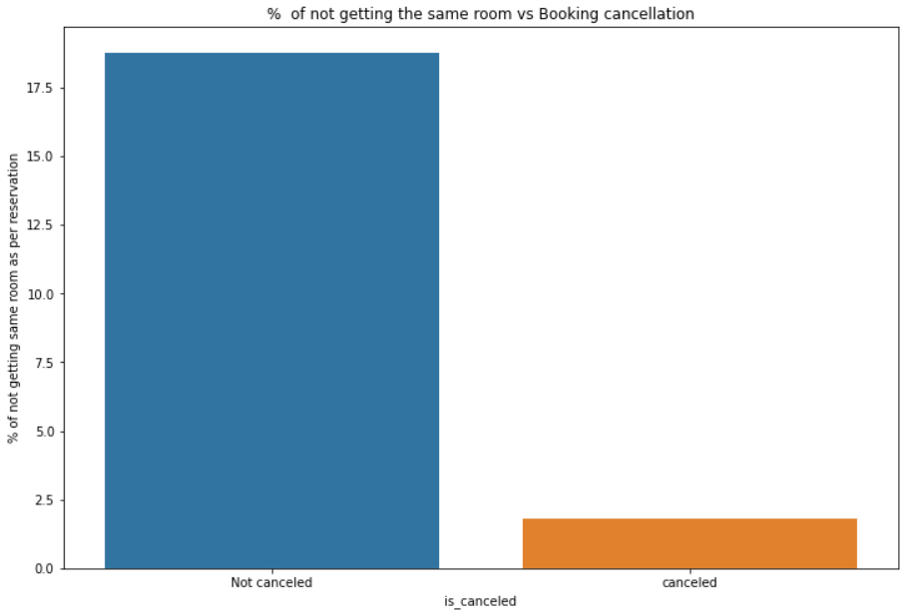
Exploratory Data Analysis(EDA):
Conclusions:
Almost 19 % people did not cancel their bookings even after not getting the same room which they reserved while booking hotel. Only 2.5 % people cancelled the booking.
Thus, not getting the same room as per reserved room is not the reason for booking cancellations.

Slide 19
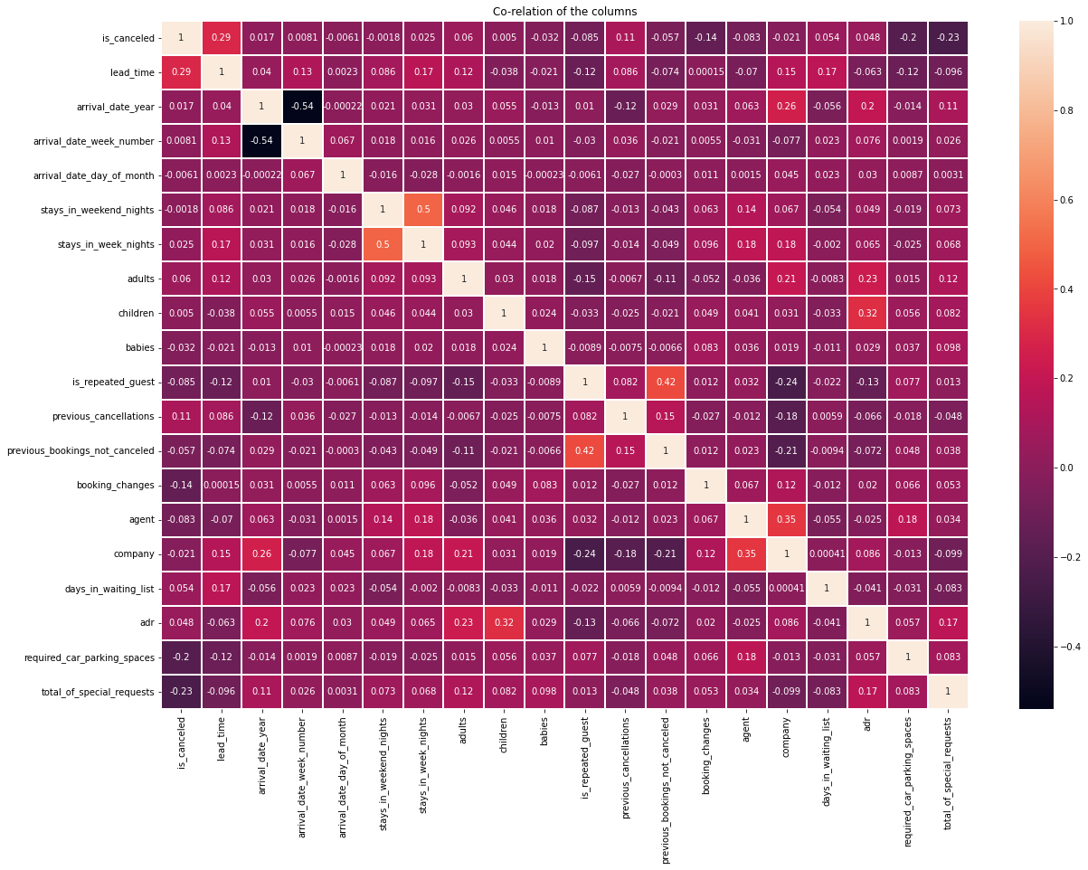
Exploratory Data Analysis(EDA):
Conclusions:
is canceled and same_room_alloted_or_not are negatively correlated. Not getting the same room as per reserved room is not the reason for booking cancellations.
lead-time and total stay is positively correlated means more is the stay of customer more will be the lead time.
ADR and total people are highly correlated. That means more the people more will be adr.High adr means high revenue
is_repeated_guest and previous_bookings Not_canceled has strong correlation. May be repeated guests are not more likely to cancel their bookings.

Slide 20
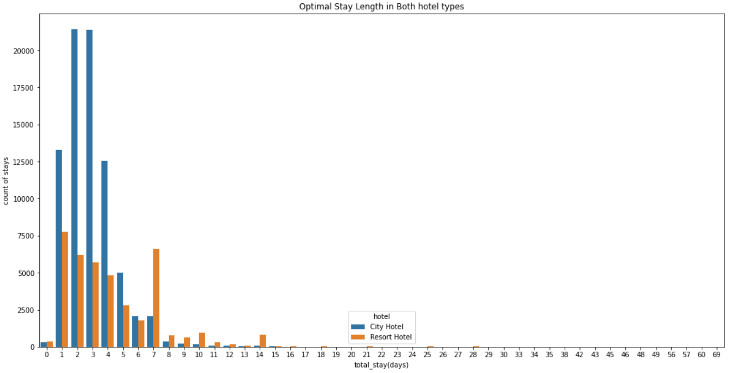
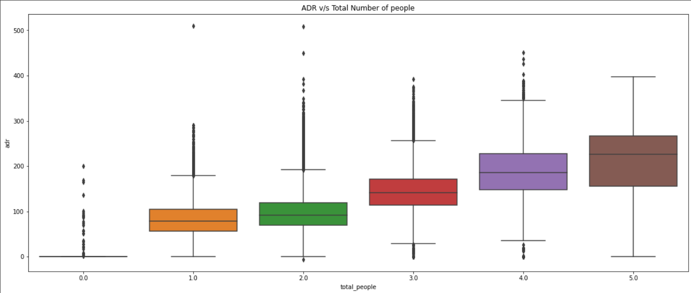
Exploratory Data Analysis(EDA):
Conclusions:
Optimal stay in both the type hotel is less than 7 days. Usually, people stays for a week.
For stay more than 7 days people likes to stay in Resort hotels. As we can see after 7 days City Hotel Bookings are very less as compared to Resort hotels.
As we saw in Correlation heatmap, total people and adr are positively correlated. Thus for 2 people ,adr is almost 100 and for 5 people its more than 200.
Thus, more the people more will revenue of the hotels.

Slide 21
Q & A

Slide 22
THANK YOU

